Slide 1
Neural Networks &
Genetic Algorithms
Bujor Pavaloiu

Slide 2
Content (1)
1. Artificial Intelligence, Machine Learnig, Connectionist paradigm
2. McCulloch & Pitts neuron model. Perceptron
3. Adaptive Linear Neurons
4. Feed-Forward Neural Networks, Backpropagation
5. Deep Learning
6. Competitive learning Kohonen Self-Organizing Networks
7. Genetic Algorithms
Neural Networks & Genetic Algorithms

Slide 3
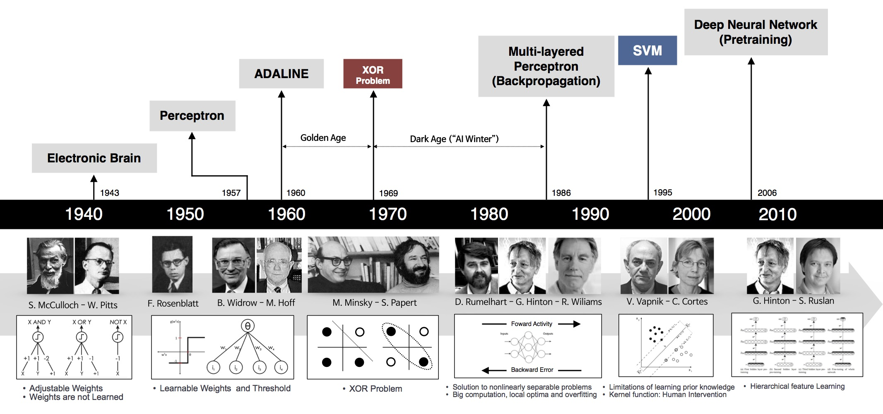
Brief history of neural networks
Neural Networks & Genetic Algorithms

Slide 4
Deep Learning positioning
Artificial Inteligence
Machine Learning
Neural Networks
Deep NNs/
Learning
Neural Networks & Genetic Algorithms

Slide 5
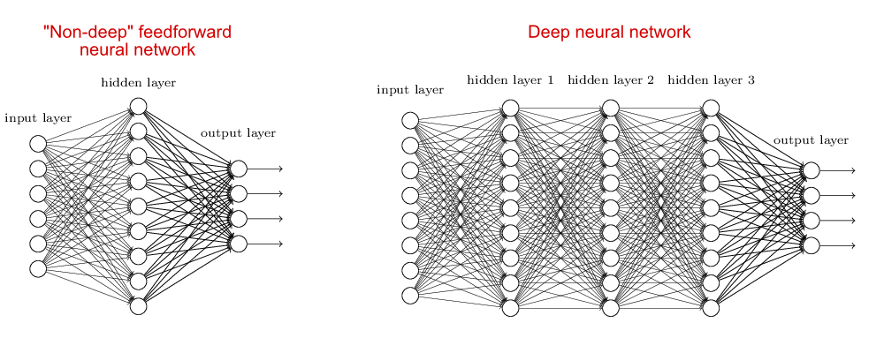
Deep NNs versus Feed-Forward NNs
Neural Networks & Genetic Algorithms

Slide 6
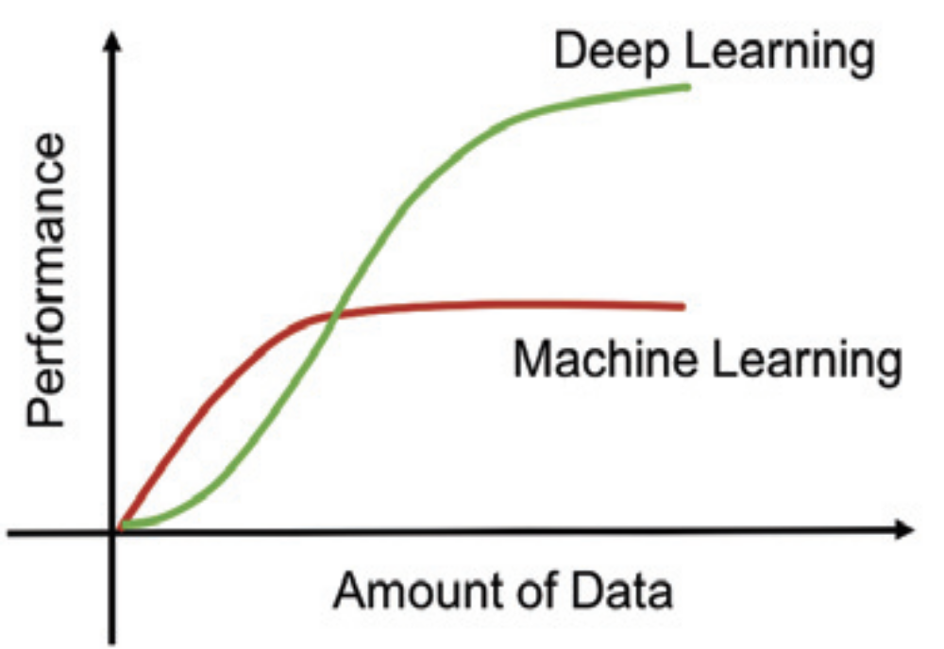
Learning performance
Neural Networks & Genetic Algorithms

Slide 7
Convolutional Neural Networks
Convolutional Neural Networks - ConvNets are a class of Neural Networks using convolutional and pooling operations for progressively learning rather sophisticated models based on progressive levels of abstraction.
This learning via progressive abstraction resembles vision models that have evolved millennia in human (and animal) brains, especially on the visual pathways.
Neural Networks & Genetic Algorithms

Slide 8
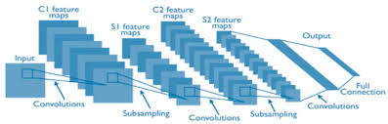
Deep Convolutional Neural Networks
Repetition of Convolution/Subsampling blocks
Neural Networks & Genetic Algorithms

Slide 9
Convolution layer
Convolution layer is defined by
  Convolution
  Stride
  Padding
Stride = the amount by which the filter shifts
Pad= the amount to extend the image size such that the result of convolution to get in the same size of the image
Neural Networks & Genetic Algorithms

Slide 10
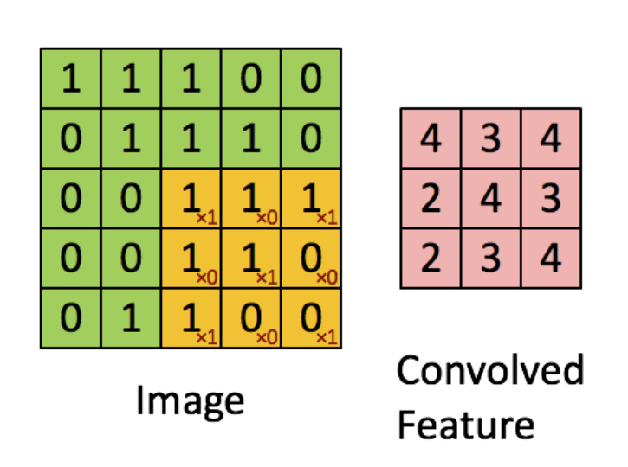
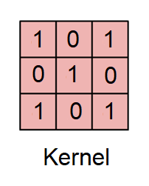
Convolution
Neural Networks & Genetic Algorithms

Slide 11
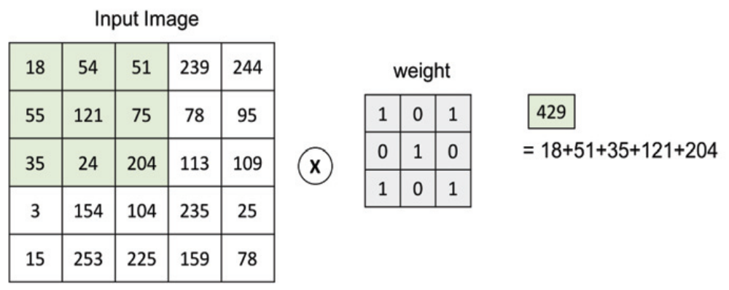
Convolution for image color plane
Kernel size 3
Neural Networks & Genetic Algorithms

Slide 12
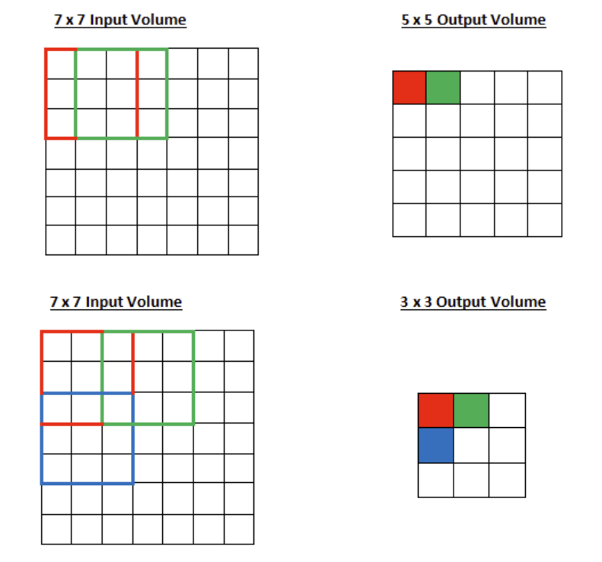
Stride
Kernel size 3
Stride = 1
Stride = 2
Neural Networks & Genetic Algorithms

Slide 13
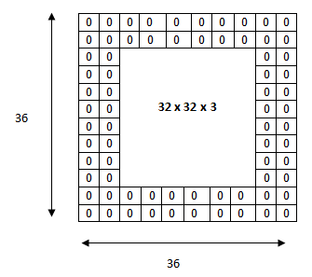
Padding
Kernel size 5
Padding from 32
to 36
Neural Networks & Genetic Algorithms

Slide 14
Pooling or subsampling layer
A pooling or subsampling layer often immediately follows a convolution layer in CNN. Its role is to downsample the output of a convolution layer along both the spatial dimensions of height and width.
The primary function of a pooling later is to reduce the number of parameters to be learned. This has also the effect of reducing overfitting and increasing the overall performance and accuracy of the network.
For color images, pooling is done separately on each color channel
Neural Networks & Genetic Algorithms

Slide 15
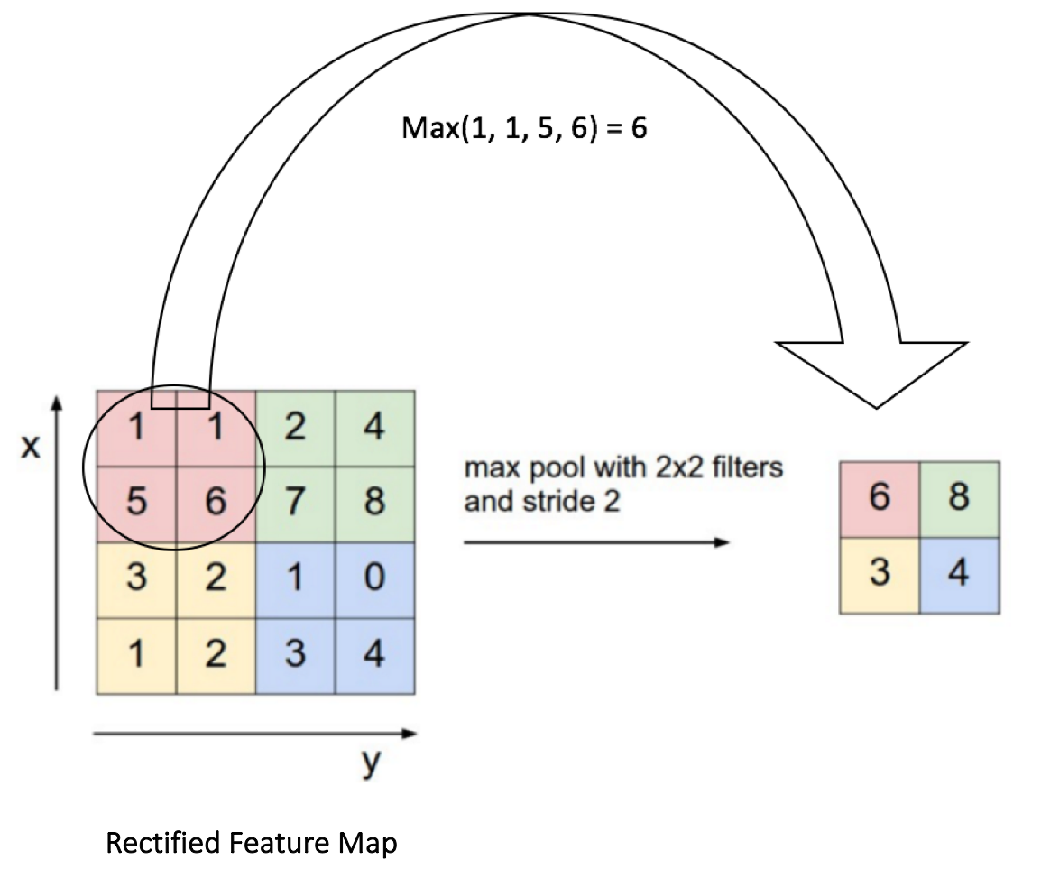
Pooling
Neural Networks & Genetic Algorithms

Slide 16
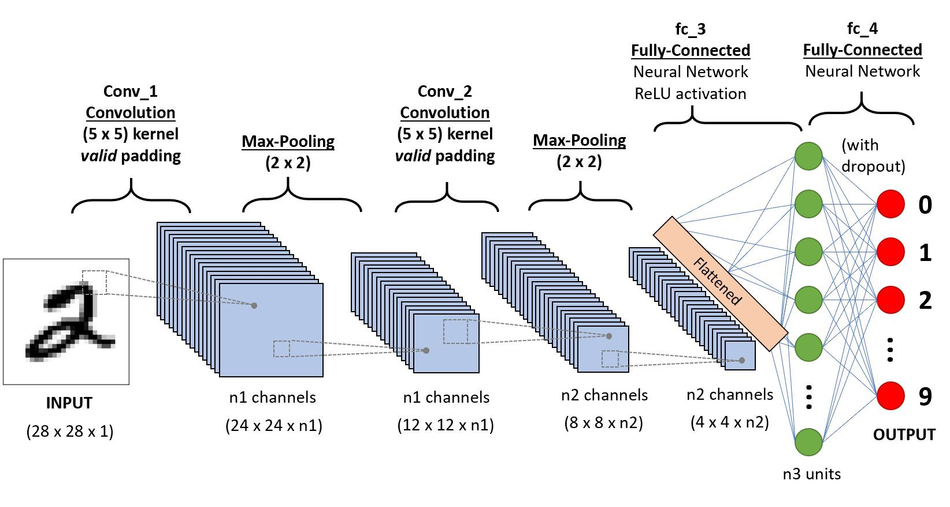
CNN for classification of handwritten digits
Neural Networks & Genetic Algorithms

